Slide 1
Scalable Data Analytics
SENG 550
AKA. Big Data - Data Engineering
Armin Zirak

Slide 2
Cloud Storage (Data Lake)
8

Slide 3
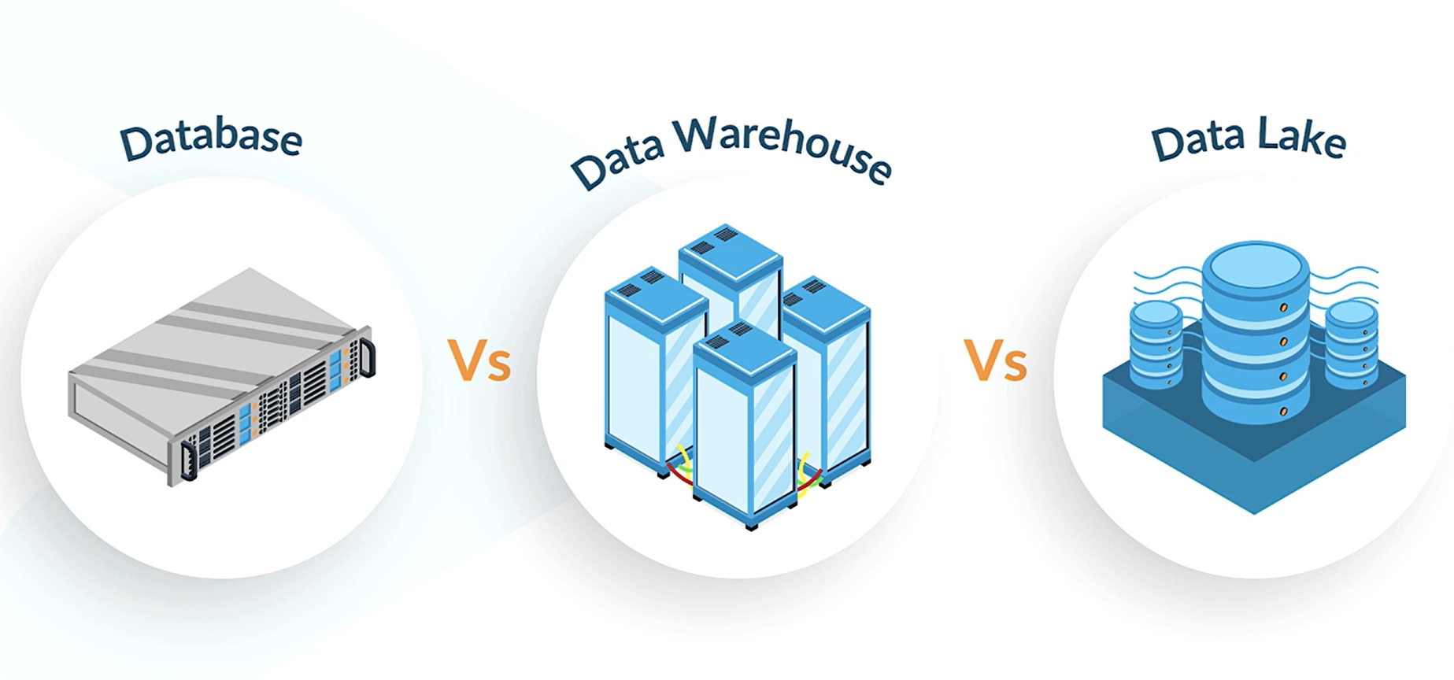
Recap - Data Warehouses vs Databases
So far, we’ve learned Data Warehouses:
Are data storage systems designed for data analysis and reporting.
Contain more data compared to databases.
Are cheaper to store large amounts of data.
Are more capable of processing large chunks of data in queries (OLAP).
Use redundant data modeling like Star Schema.
Along the same trend, we will explore cloud storage and data lakes now...

Slide 4
Limitations of DWs and DBs - Unstructured Data
What if you want to store unstructured data?
Image, Text, Files, Videos, Sensors Data.
Systems need to store these data types for
Machine Learning: Computer Vision, NLP
Core Software Functionalities
Storing users’ profile pictures.
Storing PDF documents.
For these data types, advanced search engines aren’t needed.
For example: select * from pictures where [condition] is not a regular use case when storing image data.
Often, we just need to store and retrieve files by ID.
So, data warehouse and database technologies are not helpful as they serve a different purpose.
Reminder: For example, NoSQL databases like MongoDB can handle JSON data but not large files like videos or images.

Slide 5
Limitations of DWs and DBs - History Size
Imagine you store customer payments in the data warehouse and you only need last 5 years of data for data analysis and machine learning. However, you are legally required to keep data for the last 10 years in case a customer complains about a large payment in 10 years ago.
Similarly, the university keeps your study records for two years actively but it needs to keep them for a longer time even if they are not used for any active use case.
Or, in case someone needs them after years for a new ML initiatives.
Similar to the difference between data warehouses and databases, there is a need for another technology to store more data for a longer period and be cheaper.
For example, laws like GDPR may require keeping data for audits.

Slide 6
Limitations of DWs and DBs - Backups
There is a need to make backups of data on a regular basis.
Data can be lost, like when a developer accidentally deletes tables.
An ETL pipeline applying incorrect transformations.

Slide 7
Cloud Storage
A cloud storage:
Is a cost-effective place to store large volumes of raw and unprocessed data, backups, and any datasets that don’t require the structured environment of a data warehouse or advanced search and query tools.
Stores raw data in many forms (structured, semi-structured, and unstructured).
Is designed to hold all types of data: text, images, video, sensor data, etc.
Unlike data warehouses and databases, data lakes are built to keep data in its natural format.

Slide 8



Cloud Storage
Data lakes usually use cloud storage systems to store data.
Cloud storage grows automatically as data increases.

Slide 9
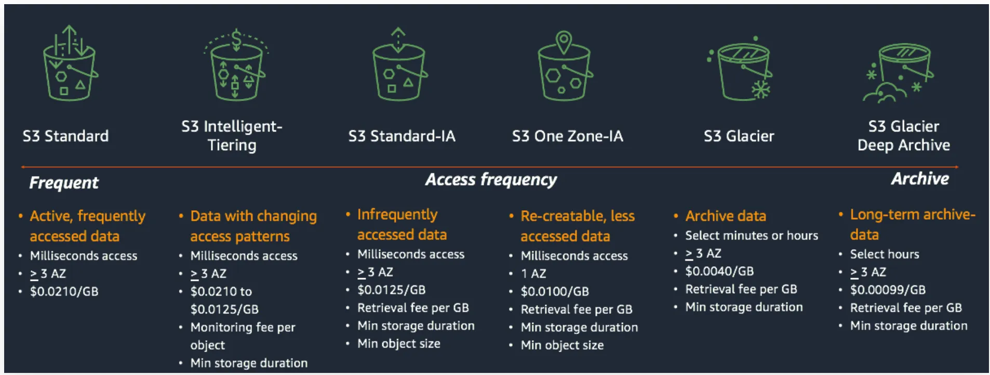
Amazon S3
Amazon S3 has different tiers itself depending on how frequent you access data.
Glacier and Archive tiers are for infrequent accesses while standard is for more frequent retrieval.
You don’t need to memorize anything from this page.

Slide 10
Cloud Storage vs Data Warehouse
 | Cloud Storage | Data Warehouse
Data | Raw and unstructured data | Processed, structured data optimized for reporting and analysis
Cost | Generally lower due to cheaper storage options | Higher, as storage is optimized for fast queries.
Performance | Lower query performance for complex analytics | High performance for analytics due to pre-processed data.
Users | Data scientists, engineers requiring raw data | Business analysts and decision-makers
Examples | AWS S3-based lake, Azure Blob Storage, Google Cloud Storage. | Snowflake, Amazon Redshift, Google BigQuery

Slide 11
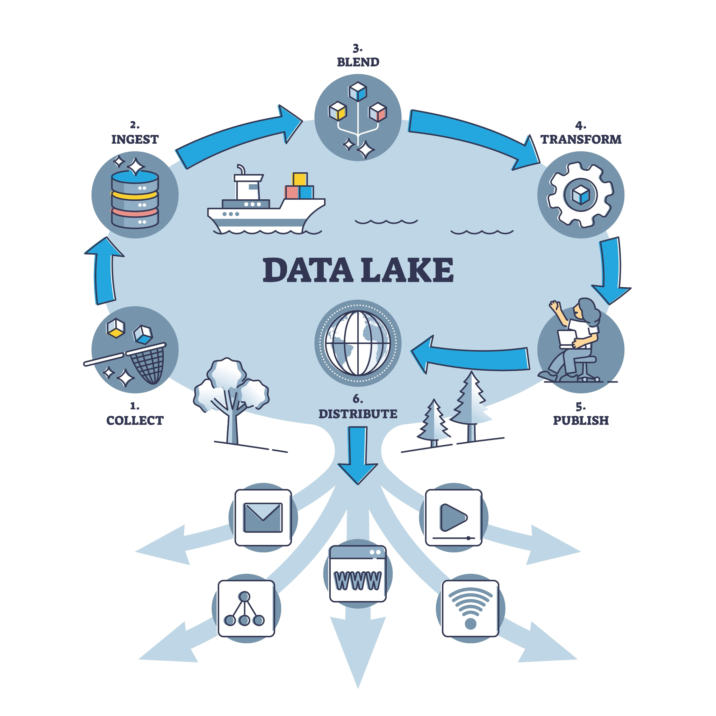
Date Lakes
Many people use Cloud Storage and Data Lake interchangeably. So, while the core idea is the same, they are not the same.
A Data Lake uses cloud storage (like Amazon S3 or Azure Blob) as its foundation to store all types of raw data at scale.
Unlike basic cloud storage, a Data Lake adds data management, processing, and analytics capabilities on top of the stored data.
Cloud Storage = Scalable, secure storage for files and data.
Data Lake = Cloud Storage + tools and architecture for big data analytics, machine learning, and real-time insights.

Slide 12
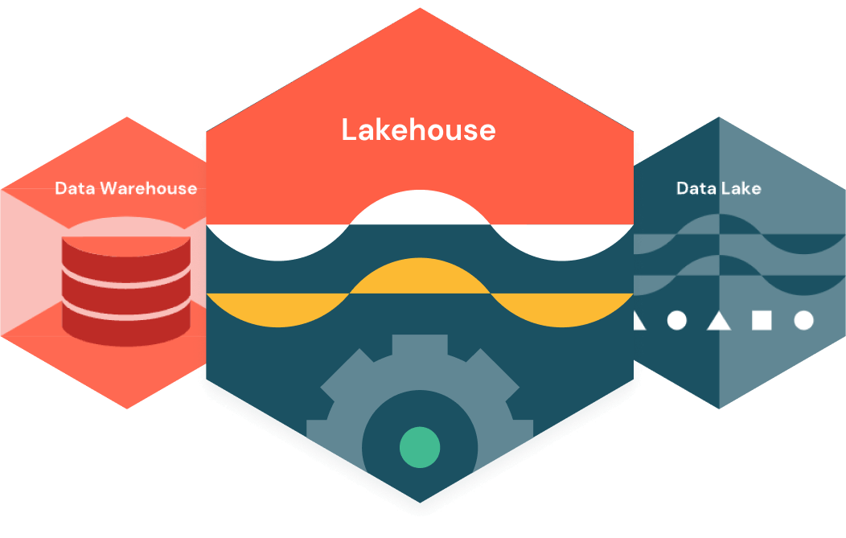
Data Lakehouse
While data warehouses and data lakes each have their pros and cons, the data lakehouse is a newer technology that combines the benefits of both.
Lakehouses are relatively new and not widely adopted in the industry.
For example, Databricks Lakehouse supports both machine learning and business analysis on the same data. (2020)

Slide 13
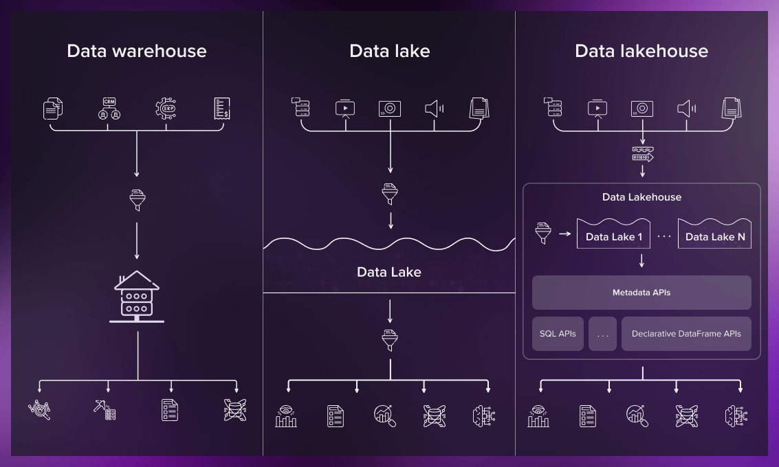
Data Lakehouse

Slide 14
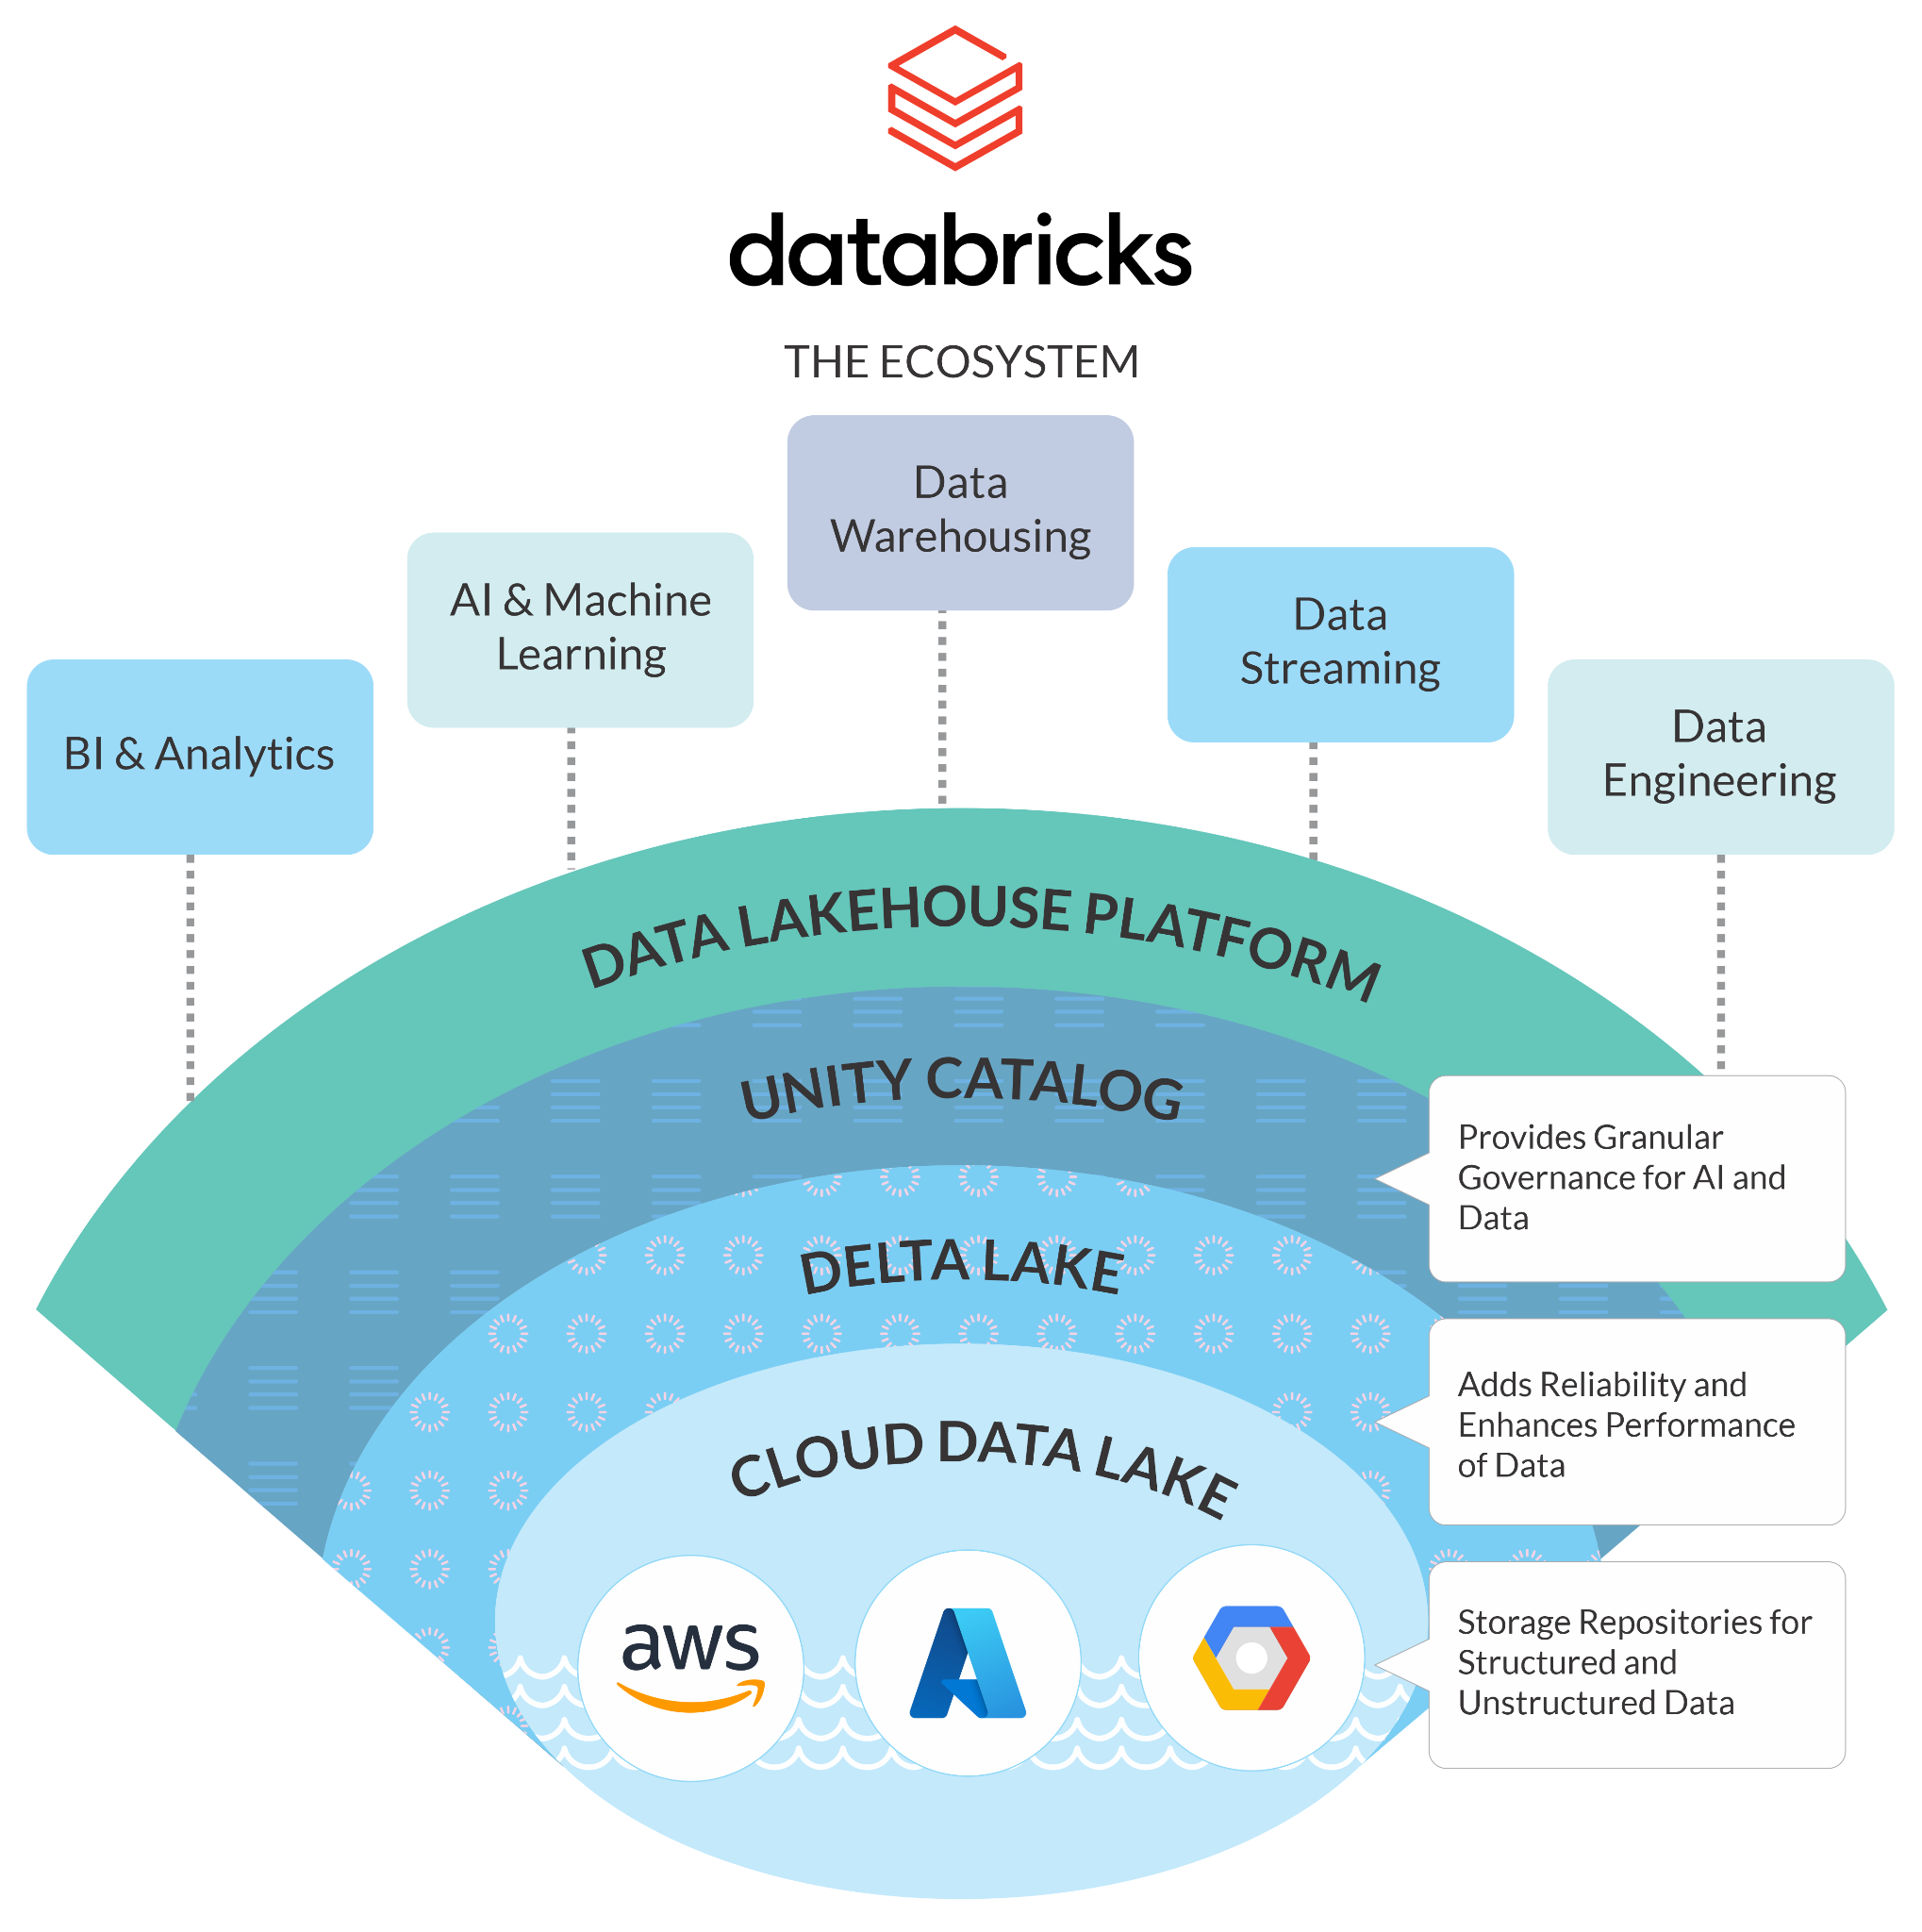
Databricks Lakehouse

